Slide 1
Projectile Calculations Notes

Slide 2
Problem Solving Tips
Carefully read the problem and list known and unknown information in terms of the symbols of the kinematic equations.
Make a table with horizontal information on one side and vertical information on the other side.
Draw a picture
Keep track of units
Identify the unknown quantity which the problem requests you to solve for.
Select either a horizontal or vertical equation to solve for the time of flight of the projectile. (Usually, we use the y components)
With the time determined, use one of the other equations to solve for the unknown.

Slide 3
Determination of the Time of Flight
The time for a projectile to rise vertically to its peak (as well as the time to fall from the peak) is dependent upon vertical motion parameters.
Factors involved - the initial vertical velocity and the vertical acceleration (g = 10 m/s², down).
THIS IS OFTEN THE KEY STEP TO SOLVING 2D PROBLEMS!

Slide 4
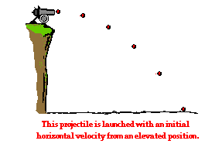
Projectile Problems – TYPE 1
A projectile is launched with an initial horizontal velocity from an elevated position and follows a parabolic path to the ground.
In this problem type v_{iy} = 0, m/s, so t = √(2d/a)

Slide 5
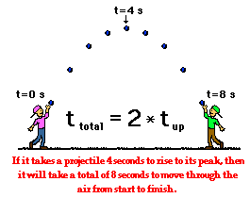
Projectile Problems – TYPE 2
A projectile is launched at an angle to the horizontal and rises upwards to a peak while moving horizontally. Upon reaching the peak, the projectile falls with a motion which is symmetrical to its path upwards to the peak.
In this problem type v_{iy} > 0,
so t_{up} = │v_{iy} /g│

Slide 6
Determination of Horizontal Displacement
v_{ix} = v_{fx} because a_{x}=0 for projectiles
The horizontal displacement is dependent upon the only horizontal parameter which exists for projectiles - the horizontal velocity (v_{ix}).
x = v_{ix} • t
If a projectile has a time of flight of 8 seconds and a horizontal velocity of 20 m/s, then the horizontal displacement is 160 meters (20 m/s • 8 s).

Slide 7
Determination of the Peak Height
The height of the projectile at this peak position can be determined using the equation
d_{y} = (v_{iy} • t) + (0.5 • a_{y} • t²)
d_{y} = Distance in the y direction, height (m)
v_{iy} = the initial vertical velocity (m/s)
a_{y} = acceleration of gravity ( -10 m/s²)
t = time in seconds it takes to reach the peak

Slide 8




Practice
A pool ball leaves a 0.60-meter high table with an initial horizontal velocity of 2.4 m/s.
Predict the time required for the pool ball to fall to the ground and the horizontal distance between the table's edge and the ball's landing location.

Slide 9

A pool ball leaves a 0.60-meter high table with an initial horizontal velocity of 2.4 m/s.
Predict the time required for the pool ball to fall to the ground and the horizontal distance between the table's edge and the ball's landing location.
Horizontal Information | Vertical Information
x = ??? v_{ix} = 2.4 m/s a_{x} = 0 m/s/s | y = 0.60 m v_{iy} = 0 m/s a_{y} = 10 m/s/s t = ???

Slide 10
A pool ball leaves a 0.60-meter high table with an initial horizontal velocity of 2.4 m/s.
Predict the time required for the pool ball to fall to the ground and the horizontal distance between the table's edge and the ball's landing location.
This is a type 1 problem so we can use t = √(2d/a)
t = √((2 x 0.60 m) / 10 m/s²)
t = 0.346 s

Slide 11
A pool ball leaves a 0.60-meter high table with an initial horizontal velocity of 2.4 m/s.
Predict the time required for the pool ball to fall to the ground and the horizontal distance between the table's edge and the ball's landing location.
Once time has been determined
x = v_{ix}•t
can then be used to solve for "x”
x = (2.4 m/s)•(0.346 s)
x = 0.83 m

Slide 12

Practice
A football is kicked with an initial velocity of 25 m/s at an angle of 45-degrees with the horizontal.
Determine the time of flight, the horizontal displacement, and the peak height of the football.

Slide 13
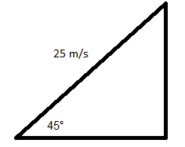
A football is kicked with an initial velocity of 25 m/s at an angle of 45-degrees with the horizontal.
Determine the time of flight, the horizontal displacement, and the peak height of the football.
Type 2 problem
Need to get v_{ix} and v_{iy}
Draw the triangle
v_{ix} = 25 m/s x cos 45° = 17.7 m/s
v_{iy} = 25 m/s x sin 45° = 17.7 m/s

Slide 14
A football is kicked with an initial velocity of 25 m/s at an angle of 45-degrees with the horizontal.
Determine the time of flight, the horizontal displacement, and the peak height of the football.
Horizontal Information | Vertical Information
x = ??? v_{ix} = 17.7 m/s v_{fx} = 17.7 m/s a_{x} = 0 m/s² | y = ??? v_{iy} = 17.7 m/s v_{fy} = -17.7 m/s a_{y} = -10 m/s² t = ???

Slide 15
A football is kicked with an initial velocity of 25 m/s at an angle of 45-degrees with the horizontal.
Determine the time of flight, the horizontal displacement, and the peak height of the football.
Solving for time
t_{up} = │v_{iy} /g│
= 17.7 m/s / -10 m/s² = 1.77 sec
t_{total} = t_{up} x 2
= 1.77 sec x 2 = 3.54 s

Slide 16
A football is kicked with an initial velocity of 25 m/s at an angle of 45-degrees with the horizontal.
Determine the time of flight, the horizontal displacement, and the peak height of the football.
To determine horizontal displacement
x = v_{ix}•t
x = (17.7 m/s)•(3.54 s)
x = 62.7 m

Slide 17
A football is kicked with an initial velocity of 25 m/s at an angle of 45-degrees with the horizontal.
Determine the time of flight, the horizontal displacement, and the peak height of the football.
To determine the peak height
d_{y} = (v_{iy} • t) + (0.5 • a_{y} • t²) Use t_{up} for time
d_{y} = (17.7 m/s•1.77 s) + [(0.5• (-10 m/s²)•(1.77 s)²]
d_{y} = 31.3 m + (-16.2 m)
d_{y} = 15.1 m

Slide 18
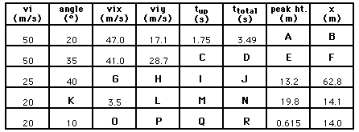
Practice
Utilize kinematic equations and projectile motion concepts to fill in the blanks in the following table.
Use g = 9.8 m/s/s for these problems

Slide 19
Answers
A: 14.9 m
B: 164 m
C: 2.93 s
D: 5.85 s
E: 42.0 m
F: 240 m
G: 19.2 m/s
H: 16.1 m/s
I: 1.64 s
J: 3.28 s
K: 79.9 deg
L: 19.7 m/s
M: 2.01 s
N: 4.02 s
O: 19.7 m/s
P: 3.47 m/s
Q: 0.35 s
R: 0.70 s

